Slide 1





Tachelhit Forced Aligner
Guillem Gili i Bueno
"Syllables in tashlhiyt berber and in moroccan arabic"
F Dell, M Elmedlaoui - 2002
Notes:
Comments during presentation 13.05.2026: ‘... intensive’ instead of ‘consonant incentive’, ‘written’ about the vowels (they are not written); dipthongs for dz … they are called ‘affricates’
Suggestion: Have a few words in a slide before this one stating what the aim of the project is and its significance. Short & punctual.
Suggestion: Add a slide with prior work/work on the same topic that precedes this project (and if none exists, state that or make parallel to other works on the same topic but in other lang families)
Citation should only be Dell & Elm… 2002, along with a p. X if this comes from some specific page; and then a separate section at end of slides with your list of References

Slide 2
Research motivations
Good benchmark for Forced Alignment
  Consonant-intensive language
  Fully-unvoiced sentences
  Epenthetic, non-contrastive (e or sometimes non-written) vowels are common
  Many realisations for the explicitly written vowels (a,i,u)
Low resource language
  Big amount of theoretical research
  Contradicting statements in research
  How do we bypass lack of corpus
  Similar language with lots of corpus

Slide 3
Ontology Berber
ber (ISO)
atla1275 (Glottolog)
kab (ISO)
shi (ISO)
tzm (ISO)
rif (ISO)
zgh (ISO)
Notes:
For the ‘uninitiated’, explain what is meant by ‘Ontology’ (by adding something in the slide)

Slide 4
Ontology Berber
ber (ISO)
atla1275 (Glottolog)
kab (ISO)
shi (ISO)
tzm (ISO)
rif (ISO)
Adjusting
33 min(mostly shi)
zgh (ISO)
Training
25 hrs(+ available)
https://huggingface.co/datasets/fsicoli/common_voice_22_0

Slide 5



Writing systems
kab(Taqbaylit, Kabyle)
zgh (Standard Moroccan Amazigh)
<-Dataset train
<-Dataset adjust
<- limited real usage
shi (Tachelhit, Tachlhit, Shilha)
tzm (Tamazight, Atlasic, Central atlas Tamazight)
<-Dataset adjust
<-Dataset adjust
Tamazight/Amazigh/Berber tend to also be used as an umbrella term to reference all Berber languages.
Notes:
Next to ‘kab’, ‘shi’ and so on, add conventional language name

Slide 6
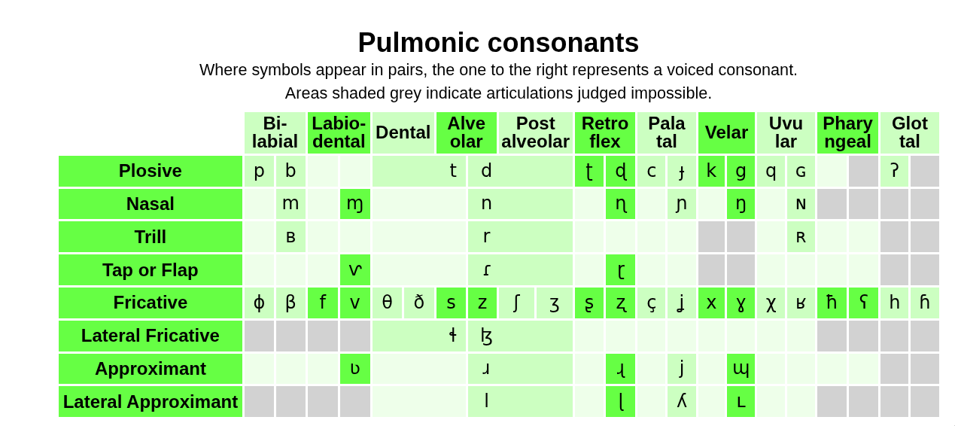

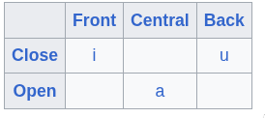


Phonological space: zgh-only
[w]
[ˤ]
[ˤ]
[w]
[w]
[w]
[w]
[ˤ]
[ˤ]
[ˤ]
[ˤ]
[w]
[w]
*
*
e
geminates (long)
xʷ theoretically exists in kab, but no examples in 25h corpus
* pharyngeals are epiglottal in shi
https://en.wikipedia.org/wiki/Shilha_language#Phonology
https://en.wikipedia.org/wiki/Central_Atlas_Tamazight

Slide 7
Phonological space: kab and zgh
[w]
[ˤ]
[ˤ]
[w]
[w]
[w]
[w]
[ˤ]
[ˤ]
[ˤ]
[ˤ]
e
geminates (long)
Table from https://www.ipachart.com/

Slide 8
Phonological space: kab-only
[w]
[ˤ]
[ˤ]
[w]
[w]
[w]
[w]
[ˤ]
[ˤ]
[ˤ]
[ˤ]
e
geminates (long)
https://en.wikipedia.org/wiki/Kabyle_language

Slide 9
Shared orthography: kab+zgh (excluding tifinagh)
PHARYNGEALIZATION
ṣ -> /sˤ/
ẓ …
ṭ …
ḍ …
ṛ -> /rˤ/
ḥ -> /ħ/
“e” -> /ə/
“e” -> //
“e” -> /e/
“e” -> /i/
“e” -> …
“x” -> /χ/
“ɣ” -> /ʁ/
“y” -> /j/
GEMINATES
“gg” -> /g:/
“bb” -> /b:/
…

Slide 10
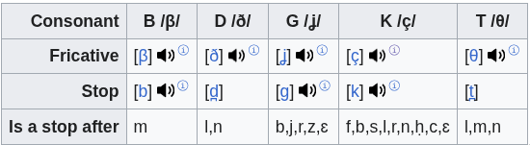
Realizations: affricates vs stops
kab
zgh
/β/
/b/
“b”
“b” -> /b/
“t” -> /t/
“d” -> /d/
“g” -> /g/
“k” -> /k/
/θ/
/t/
“t”
“d”
/ð/
/d/
“g”
/ʝ/
/g/
/ç/
/k/
*β,θ and other first-liners are the default pronunciation, their alternative only being used after specific consonants (or geminating)
“k”
https://en.wikipedia.org/wiki/Kabyle_language

Slide 11
Orthography ambiguity:
kab
zgh
/mʷ/
/m:w/
Unambiguous writing of labial., pharyng. in Tifinagh
“ⵎⵯ”-> /mʷ/
“ⵙ” -> /s/
“ⵚ” -> /sˤ/
Symbols for spirant. exist but not commonly used:
“ⴸ” -> /ð/ (rarely used)
“ⴷ” -> /d/
“mmw”
/gʷ/
/g:w/
“ggw”
/kʷ/
/k:w/
“kkw”
“xxw”
/χʷ/
/ʁʷ/
Not found in kab corpus
“ɣɣw”
/qʷ/
/q:w/
“qqw”

Slide 12
Pronunciation particularities zgh
Contrastive gemination
“tett” != “ttet”
Assimilation (and gemination) forward
at dna -> /ad:na/ (/addna/)
Ambiguous pron. in 3-gemination:
Att ta -> /attta/ or /att.ta/
"Syllables in tashlhiyt berber and in moroccan arabic"
F Dell, M Elmedlaoui - 2002

Slide 13
Irregularities in orthography:
kab
zgh
/nw/
/nbw/
/npw/
“nw”
“n” preposition assimilates
“ad”,“rad” particles assimilate or drop the /d/
/bʷ/
/w:/
“ww”
/g/
/j:/
"Syllables in tashlhiyt berber and in moroccan arabic"
F Dell, M Elmedlaoui - 2002
“yy”
/ʁ:/
/q:/
“ɣɣ”
“tt”
/ts/

Slide 14

Notes on sources:
zgh
kab
Main source has been "Syllables in tashlhiyt berber and in moroccan arabic"
F Dell, M Elmedlaoui - 2002
Cross-compared with wikipedia’s source for shilha:
Ridouane, R. (2014). Tashlhiyt Berber. Journal of the International Phonetic Association, 44(2), 207-221.
And private conversations with some native speakers (with a linguistic background):
https://www.linkedin.com/in/abdelhaqueidali/
Hicham
Main source has been wikipedia, cross-referencing with a native speaker: Kabyl Singer “Massyl Aït-Ahmed” https://www.youtube.com/@massinissaait-ahmed4875

Slide 15


Montreal Forced Aligner
“stop”
Monophone models
Triphone model (context per-phone on each side)
LDA + MLLT (maximize phone differences)
Unifying speaker information (calculate MFCCs)

Slide 16
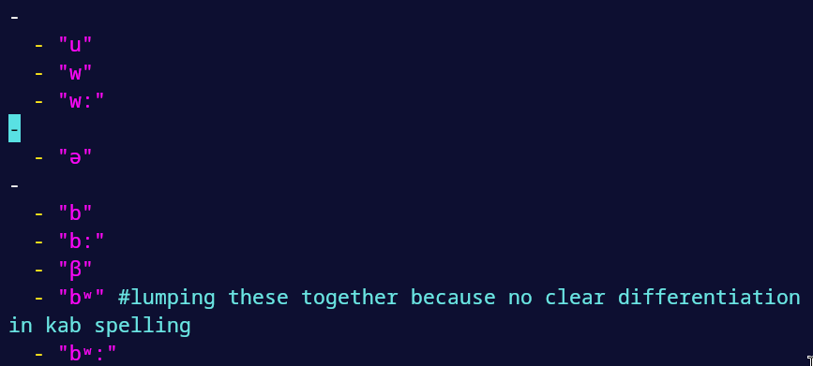
Implementation quirks: Phone groups
Applied in triphone step (to cluster similar sounds)
Built-in way to handle different realizations.

Slide 17
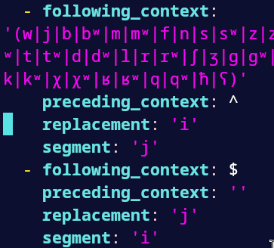
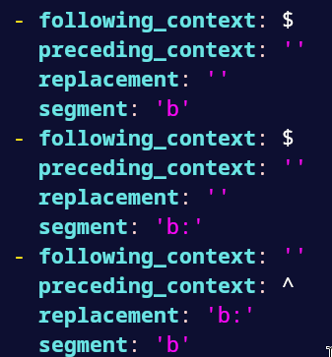
Implementation quirks: Replacement rules
MUST BE APPLIED TO ENTIRE VOCABULARY
In-word assimilations(and geminates) are handled prior.
Assimilation/geminate handling
“b:” will have /bb/ and /bbb/ as realizations
No-HIATUS rule is applied this way

Slide 18
Implementation overview
Setup data (order of steps is indifferent)
  Generate pron. dictionaries
  Resample audios to 16k Hz, change precision to 16bit, change to .wav
  Generate textgrids
Train aligner from 0 based on kab (25 h, phone groups/rules can only be specified here).
Adjust aligner based on zgh dataset (30m)
Align longest samples of zgh (20 shi/20 tzm)
Compare to golden alignments
  Manual annotation (DONE)
  Comparison algorithm implementation (TODO)
  Suggest Training setups (TODO)
    Alternative base training
    Different phone grouping (separating emphatic consonants from their counterpart, separating geminates)
*All of this runs multithreaded, and <20Gb of memory. One has to be careful with disk only.

Slide 19
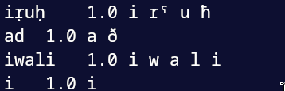
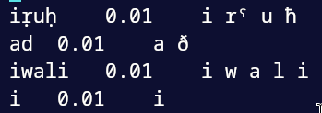
Implementation quirks: Pron. dictionaries
Possibility of a kab word when training on kab corpus is max, possibility of a kab word when adjusting to zgh corpus is minimal. Reverse also true
Kab version (kab words)
zgh version (kab words)

Slide 20
Implementation: Evaluation suggestion
Custom algorithm for alignment evaluation:
Target with FA is per-word
Absolute distance between phones from 2nd to 2nd-to-last.
Assimilation may geminate, and the implementation
  /ut/ +/tu/ = /uttu/= /ut:u/
  /utt/ +/tu/ = /utt.tu/ (/ut:.tu/) or /utttu/ (/u.t:u/) are correct realizations
  /ut/ +/ttu/ = /ut.ttu/ (/ut.t:u/)or /utttu/ (/u.t:u/) are correct realizations
Alignments can be per-word good, but with very bad assimilation handling

Slide 21
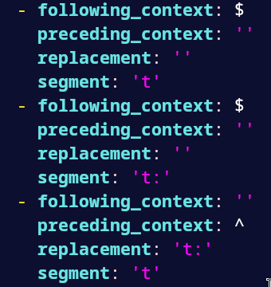
Example for 2nd to 2nd-to-last
“att tat” has 2 correct pronunciations /att.tat/ or /attt.at/ :
Geminate in-word is detected: /a t: t a t/
Model can choose
  /a t: t a t/
  /a t: a t/ (where t: is /ttt/)
  /a t: t: a t ( incorrect)
Both a and b cover the correct realizations. With /at.ttat/, the options are:
/a t t: a t/
/a t: at/ (where t: is /ttt/)
Which are all the correct realizations. With /at.ta/:
/a t: a t/
/a t. t a/ (incorrect)
Note that “t:” includes both realizations /tt/ and /ttt/, which is not a problem(/ttt/ will not exist in-word with a different symbol).
Keep in mind replacements

Slide 22
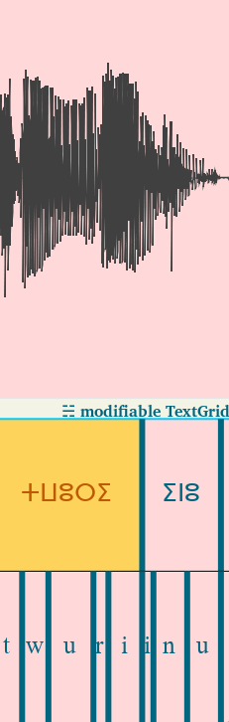
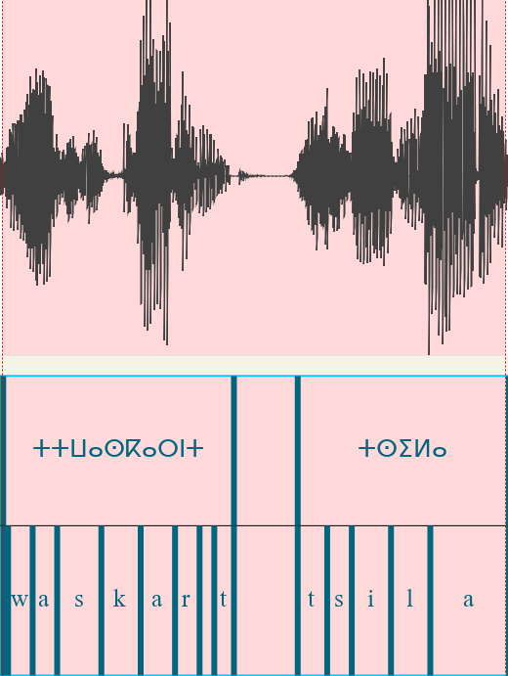
Examples (pro-excluding 1st and last character)
Misslabel (/twriynu/)
But word boundary is good.
Misslabel (/waskarnt:sila/)
But word boundary is good.
tzm/Common_voice_22_0_5
shi/Common_voice_22_0_0

Slide 23
Previous work
https://www.memcauliffe.com/how-much-data-do-you-need-for-a-good-mfa-alignment.html
Study on how many speakers are a good threshold to have for MFA particularly
Rough suggestion is 20 hours
“The more nuanced answer is that when there’s a pretrained model on 20+ hours of speech similar to the variety you’re trying to align, that will likely generate pretty good alignments”
https://montreal-forced-aligner.readthedocs.io/en/latest/user_guide/troubleshooting.html#errors-training-on-small-corpora
Official suggestion is 1000 hours for something generalizable but at least several (how many?) are needed.

Slide 24
Previous work
https://huggingface.co/datasets/TutlaytAI/kabyle_asr
https://huggingface.co/datasets/TutlaytAI/moroccan_amazigh_asr
Moroccan Amazigh ASR contains kab (not shi,tzm or zgh) and is clearly mislabeled. Given that common voice validates more reliably, dropping these both.

Slide 25
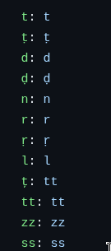
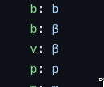

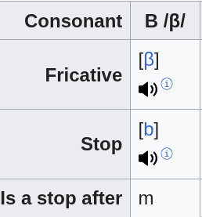
Previous work
From paper code:
Haberland, C., & Lao, N. (2021). Orthographic Transliteration for Kabyle Speech Recognition. In Proceedings of the 4th International Conference on Natural Language and Speech Processing (ICNLSP 2021) (pp. 21-32).
https://github.com/berbertranslit/berbertranslit/blob/main/data/latin_norm/latin_prealignment.yml
Good reproducibility, shallow domain knowledge (resulting in inaccurate implementation)
Interesting for comparison on per-consonant metrics
My findings:

Slide 26
Exclusions
Syllabification: too complex for project. This extends to particularities of shi that require it. I have documented a list of these in-code as potential extensions.
Spirantizations: contradictory sources
  Geminates at the junction of phonetics and phonology -> “Velars may be realized as palatals”
    (author proceeds to self-cite “La spirantisation dans un parler berb{\`e}re du Maroc (parler chleuh de Haha)”
  From “Syllables in tashlhiyt berber and in moroccan arabic" “Prevocalic voiceless stops are unaspirated”
  Probably due to dialectal variance.
Non-geminated cross-word assimilations: I don’t trust finding consistent dialect assimilations(and not critical for a FA, also geminated assimilations partially deal with this).
kab cross-word assimilations outside gemination.
"Syllables in tashlhiyt berber and in moroccan arabic"
F Dell, M Elmedlaoui - 2002

Slide 27
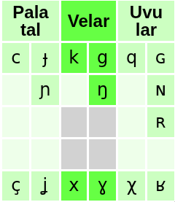
Notable considerations
/m/ and /n/ are considered stops
Consistent in rules proposed by the book:
"Syllables in tashlhiyt berber and in moroccan arabic"
F Dell, M Elmedlaoui - 2002
“h” is voiced /ɦ/ in shi/rif but voiceless in tzm /h/
Conflicting sources* for “ⴿ” (aspirantized “ⴽ”):
  According to Neo-Tifinagh* “ⴿ”-> /x/
  According to native speaker “ⴿ”-> /ç/
  Well-stablished that:
    “ⴽ” -> /k/
    “ⴳ” -> /g/
    “ⴴ” -> /ʝ/
    “ⴸ” -> /ð/
    “ⴷ” -> /d/
  “ⵅ” is (acc. to speaker /χ/, differentiated with /x/)
*https://en.wikipedia.org/wiki/Tifinagh#Neo-Tifinagh_letters
https://www.linkedin.com/in/abdelhaqueidali/

Slide 28
Manual analysis: SHI
Cross-word Assimilations/Geminates plainly ignored
/b/ performing very badly
Confirmed several assimilation rules/voicing
MFA performs very well with noise (hiccups)
MFA performs very badly in single-consonant prepositions/clitics (likes inserting empty spaces)
Vowel realization are EXTREMELY varied (sometimes adding glides during realization)
shi/common_voice_22_0_19 confirms /t + d+ t/ can also be pronounced /ttt/.

Slide 29
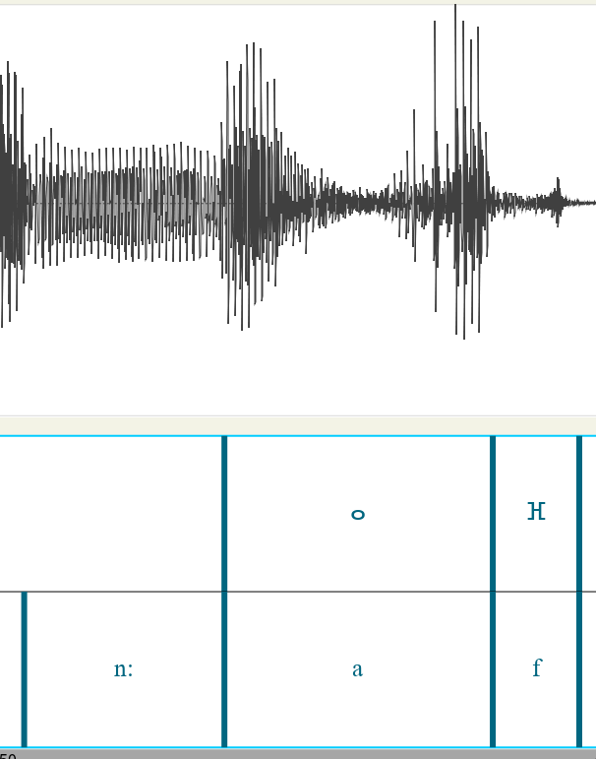
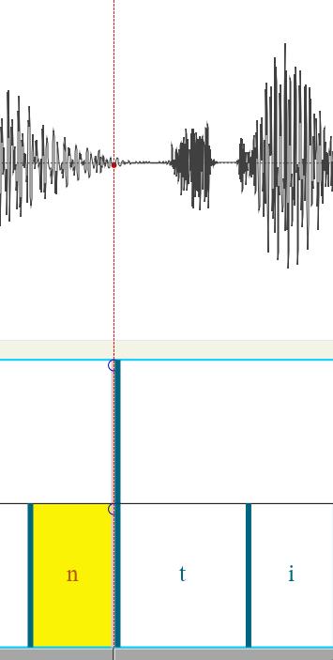
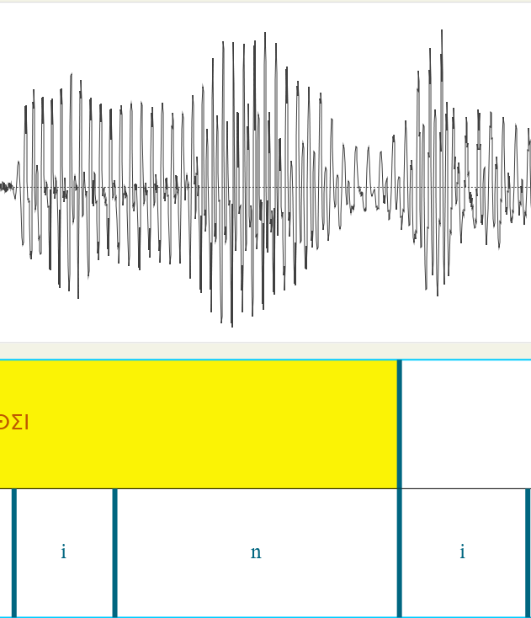
Manual analysis: MFA gets through hiccups
(Automated annotation) Hiccups get labeled properly (MFA) /a/ example
(Automated annotation) Hiccups get labeled properly (MFA) /t/ examples
(Automated annotation) Even and n where a voicoid stuck in-betweeen gets properly labeled
shi/Common_voice_22_0_0
shi/Common_voice_22_0_1
shi/Common_voice_22_0_3

Slide 30
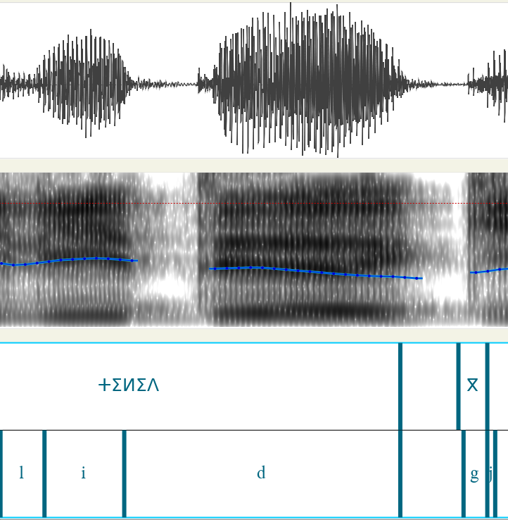
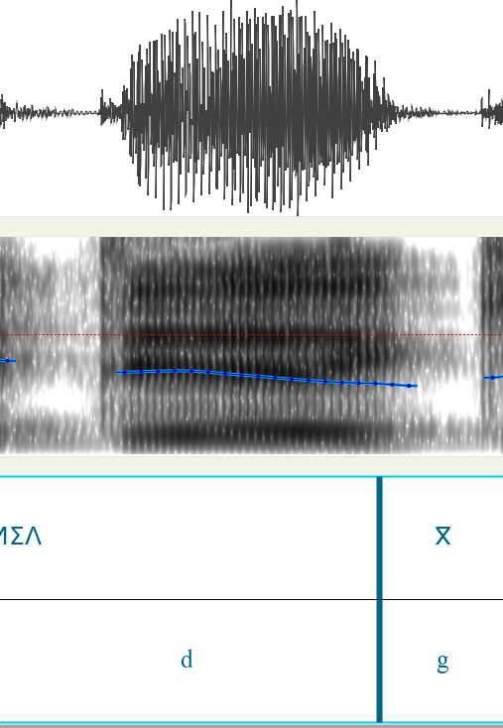
Manual analysis: MFA gets through hiccups mostly*
(left is automated, right is manual) when many epenthetic between-words vowels are there, labeling is worse.
shi/Common_voice_22_0_4

Slide 31
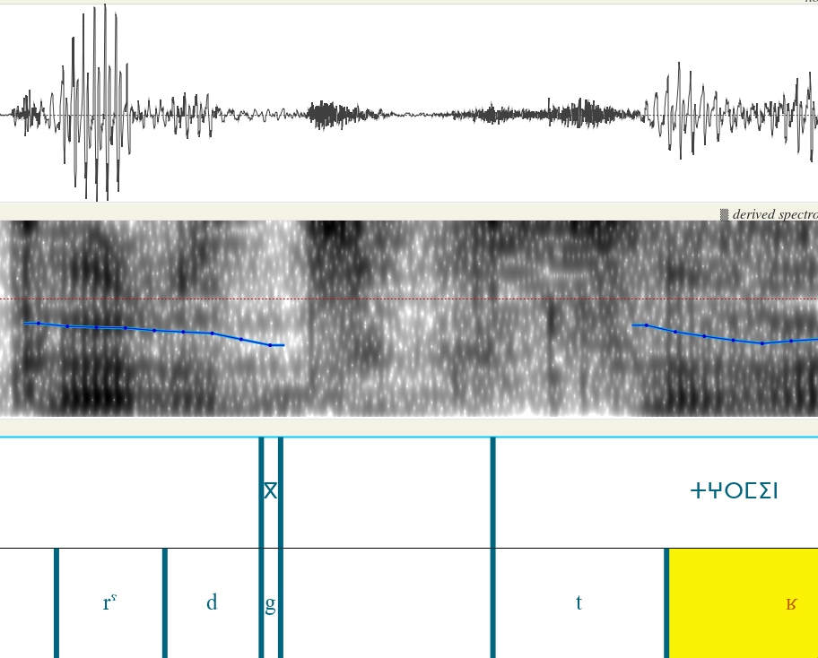
Manual analysis: Issues with solo consonants
shi/Common_voice_22_0_4
shi/Common_voice_22_0_5

Slide 32
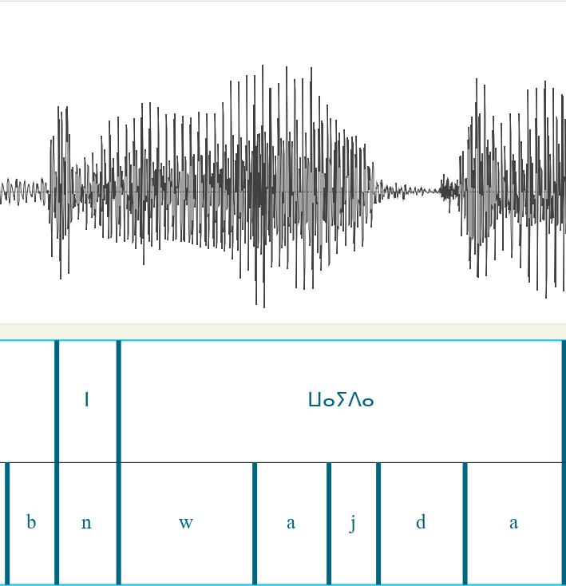
Manual analysis: Incongruence with source
(Manual annotation) “n” preposition pronounced /n/ before /w/ (according to "Syllables in tashlhiyt berber and in moroccan arabic" p. 46 this “n” should assimilate to /w/ as u, but /n/ is clearly audible)
shi/Common_voice_22_0_1

Slide 33
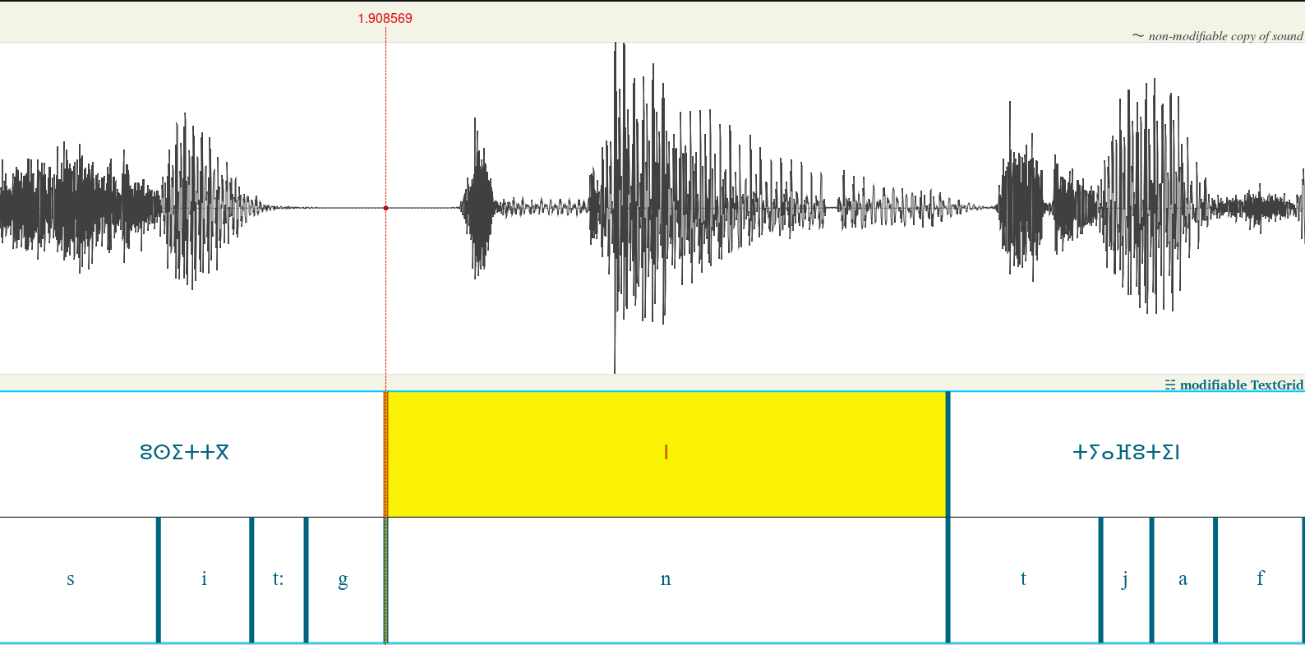
Manual analysis: limitations due to corpus size
(Automated annotation) gemminate “tt” not learned. Unsurprising given “tt” is /ts/ in kab but /t:/ in shi/tzm
shi/Common_voice_22_0_1

Slide 34
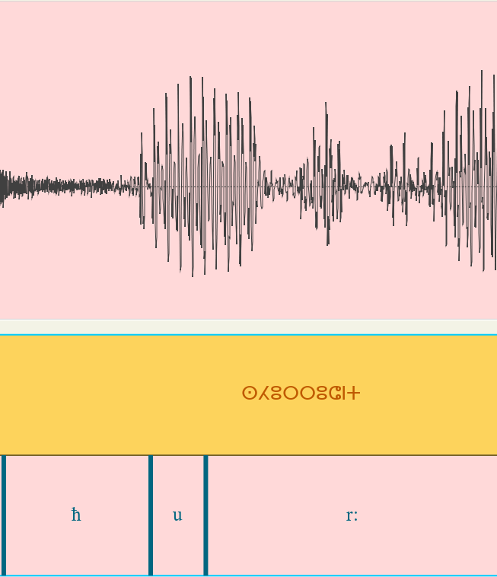
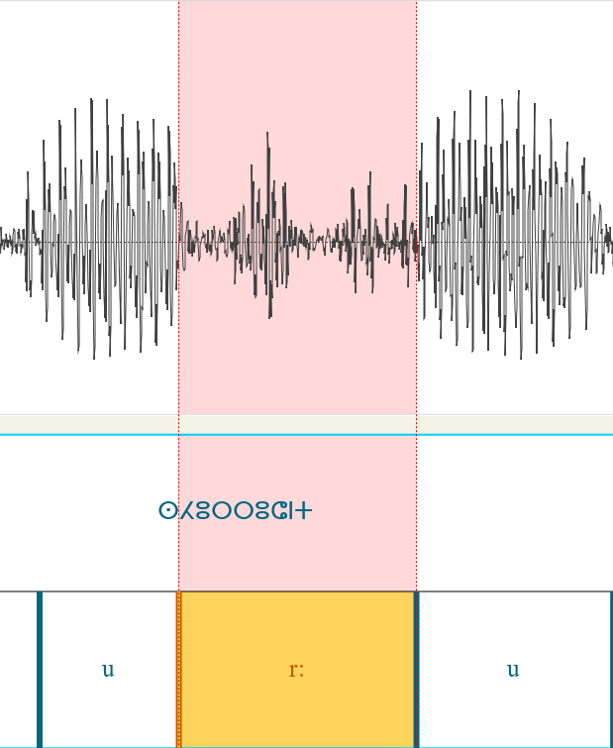
Manual analysis: MFA struggles in rhotic vs vowels
geminate aproximant vs. vowel threshold is difficult for MFA (left is automated, right is manual annotation). Strange because /r:/ is in kab. Anecdotally I can say that is not true for glides /w/ and /j/ vs vowels and nasals /n/,/m/ vs vowels.
shi/Common_voice_22_0_2

Slide 35
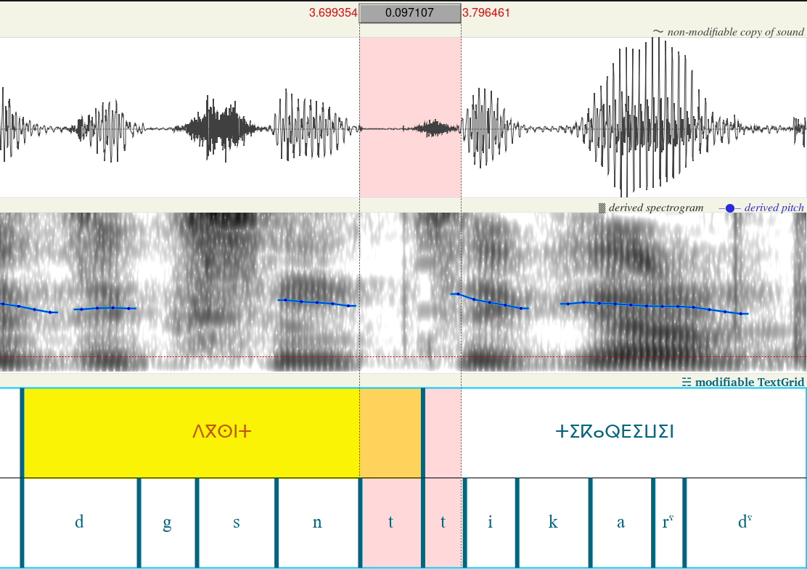
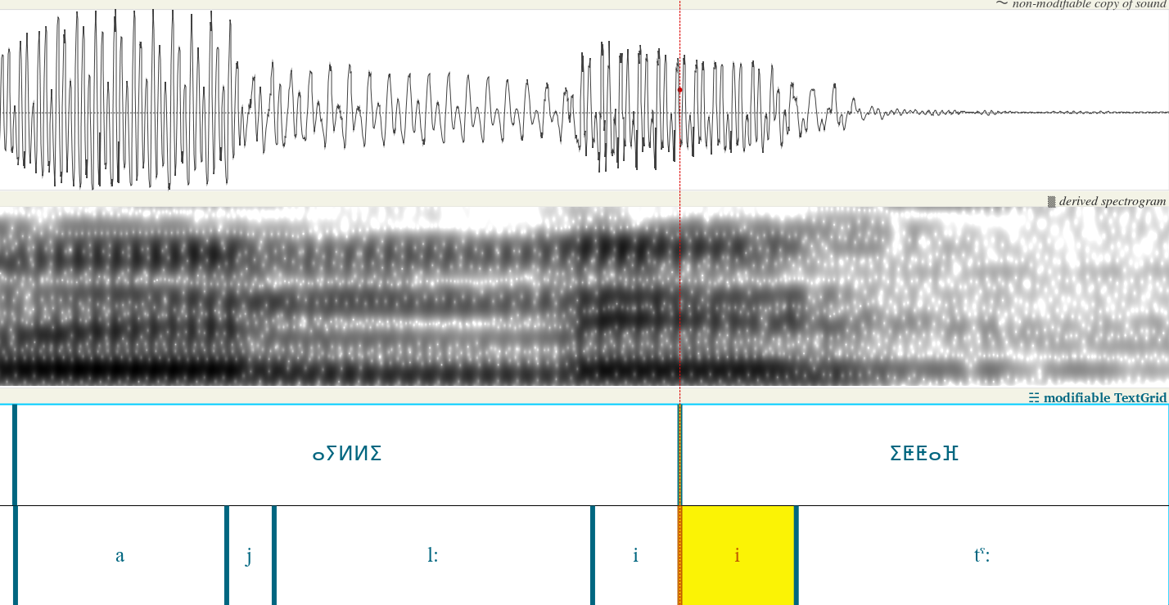
Manual analysis: MFA struggles with inter-word merging
(automated labeling) /i/ does not get replaced by /j/ even when we give MFA the tools to do so. The same applies for inter-word geminate /t:/. Lack of corpus.
shi/Common_voice_22_0_2
shi/Common_voice_22_0_5

Slide 36
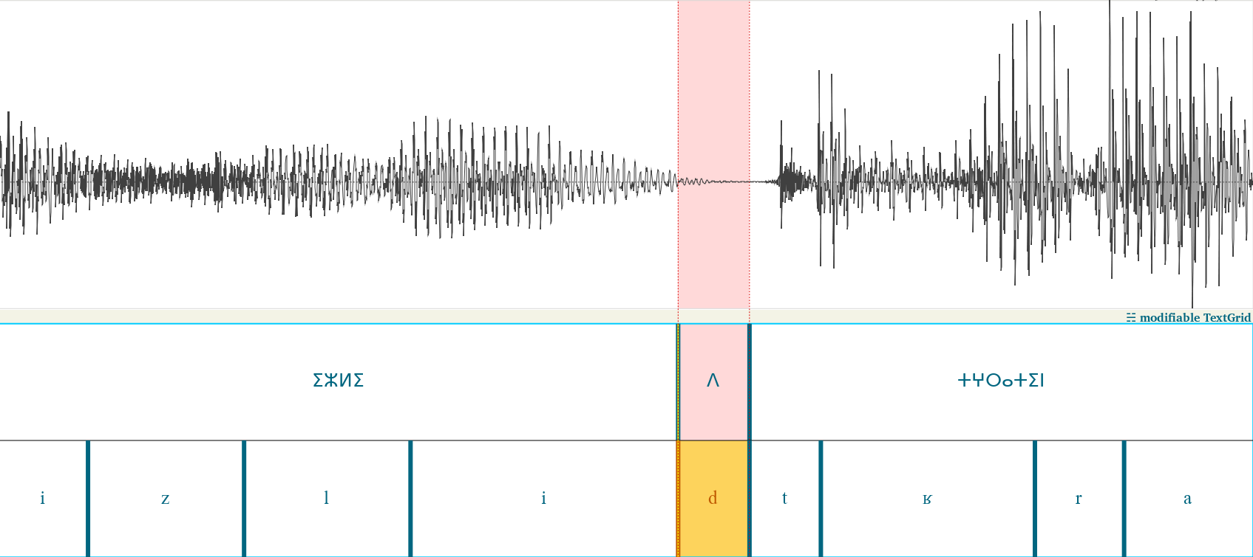
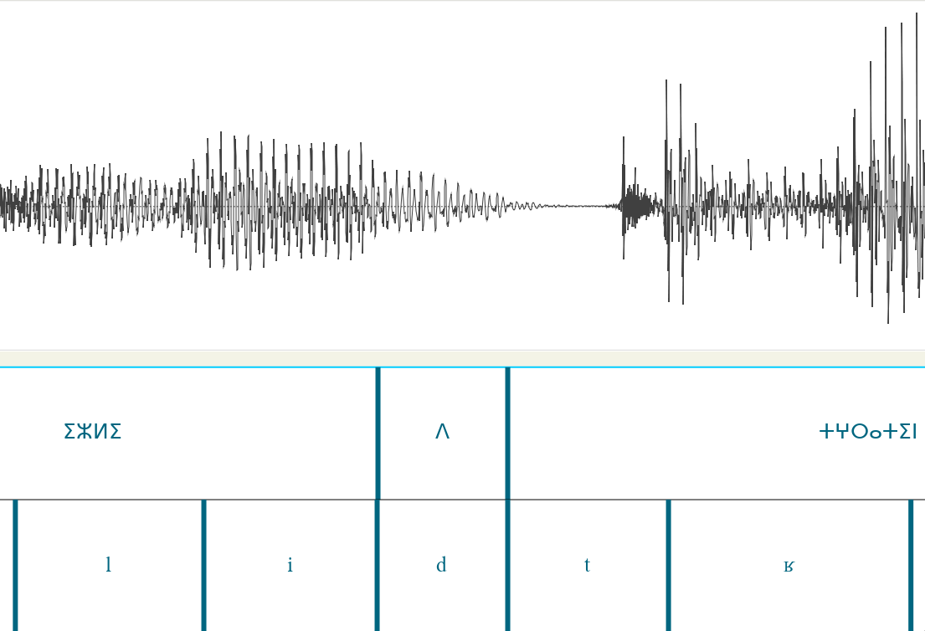
Manual analysis: irregular pronunciation
Annotated “d” is pronounced /n/ before /t/ (left is automated, right is manual annotation)
shi/Common_voice_22_0_2

Slide 37
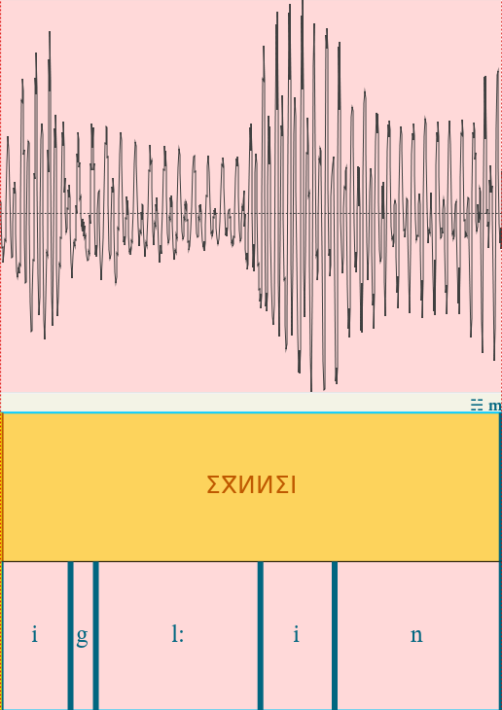
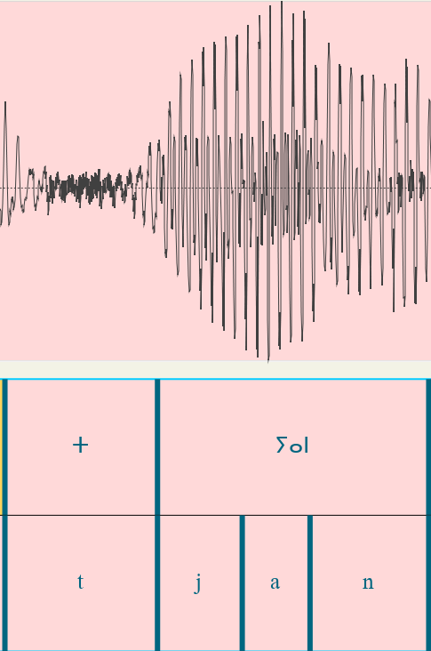
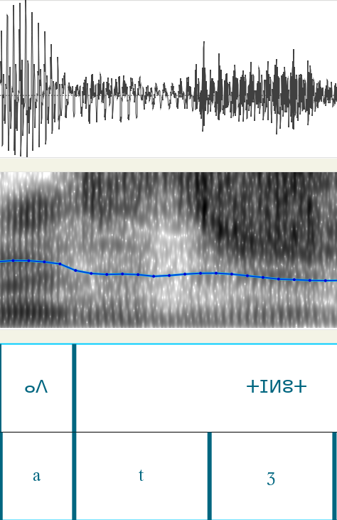
Manual analysis: Unaccounted assimilations
/igl:in/ is realized as /il:in
/t.jan/ is realized as /z.jan/
/adtʒ/ is realized as /az:ʒ/ (happens in /t/ and /d/)
shi/Common_voice_22_0_3
(also in Common_voice_22_0_6,
also in Common_voice_22_0_11,
also in Common_voice_22_0_12)
shi/Common_voice_22_0_3
shi/Common_voice_22_0_6

Slide 38
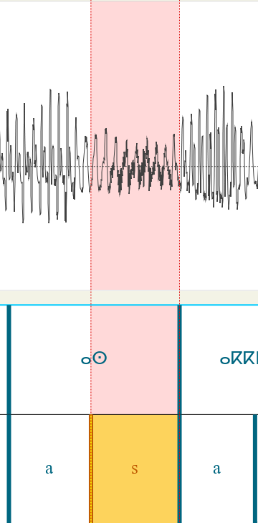
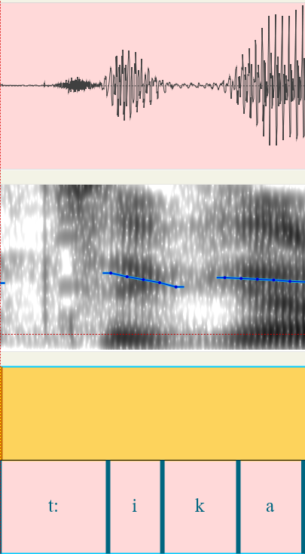
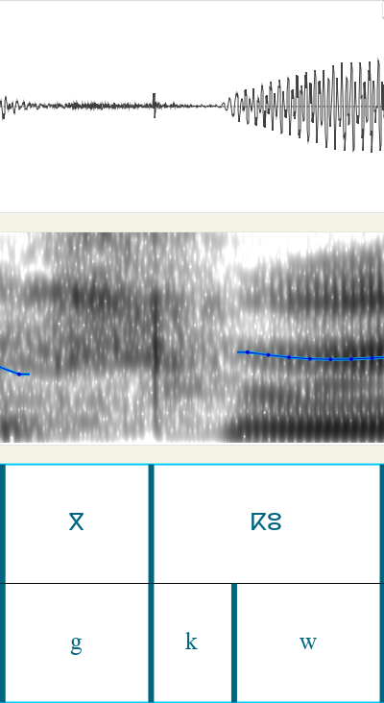
Manual analysis: Unaccounted assimilations
/k/ becomes voiced /g/ (betwen vowels and voiced such as /n/ /r/).
/g/ assimilates to /k/ AND spirantizes resulting in /ç/
Intervocalic /s/ becomes voiced /z/
shi/Common_voice_22_0_5
shi/Common_voice_22_0_5
shi/Common_voice_22_0_3

Slide 39
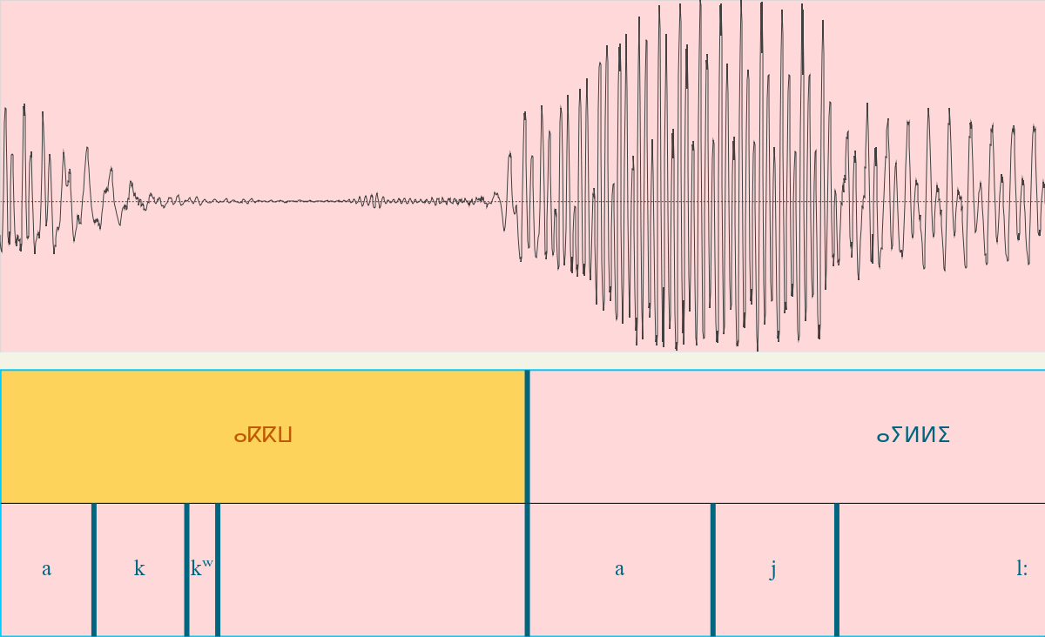
Manual analysis: Unaccounted orthography
Geminate + labialization = “ⴰⴽⴽⵯ ” would intuitively be /akkʷ/ but is pronounced /akʷ:/ (misslabel example)
shi/Common_voice_22_0_3

Slide 40
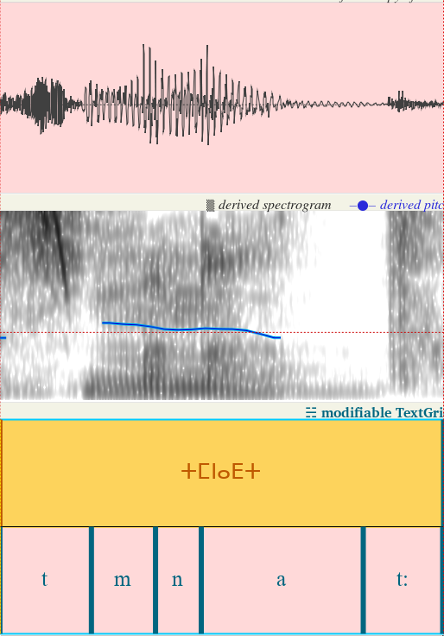
Manual analysis: Unaccounted orthography
pharyng + Geminate= “ⵜⵎⵏⴰⴹⵜ” assimilates as well
shi/Common_voice_22_0_14

Slide 41
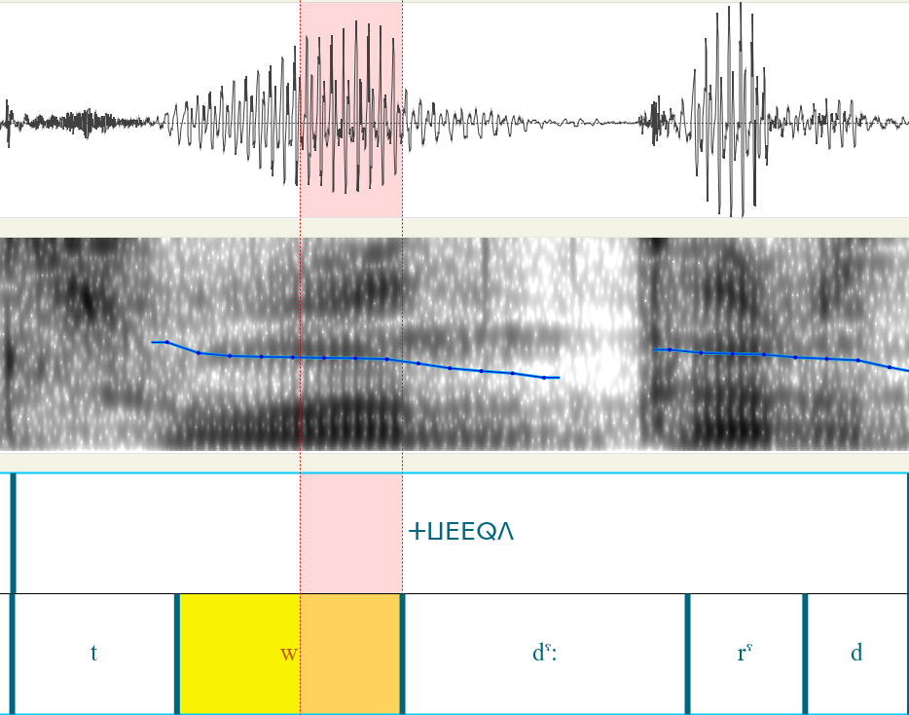
Manual analysis: Unaccounted orthography
Epenthetic vowels can be nasals (highlighted segment sounds like /n/)
shi/Common_voice_22_0_5

Slide 42
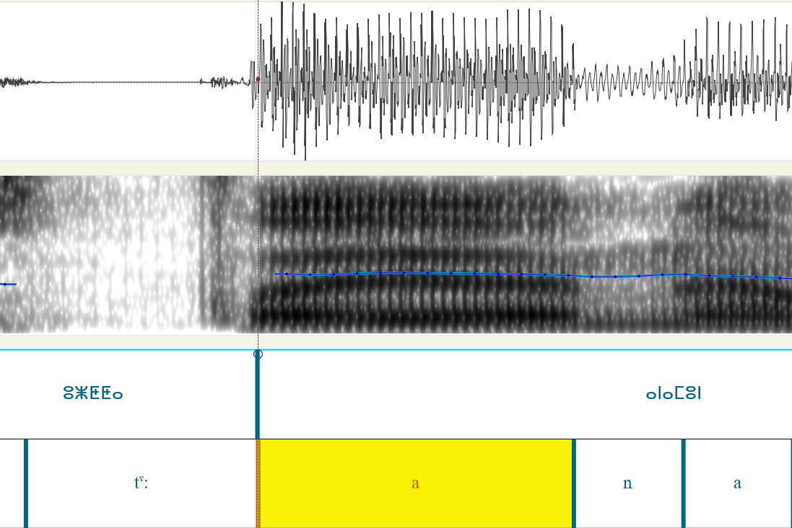
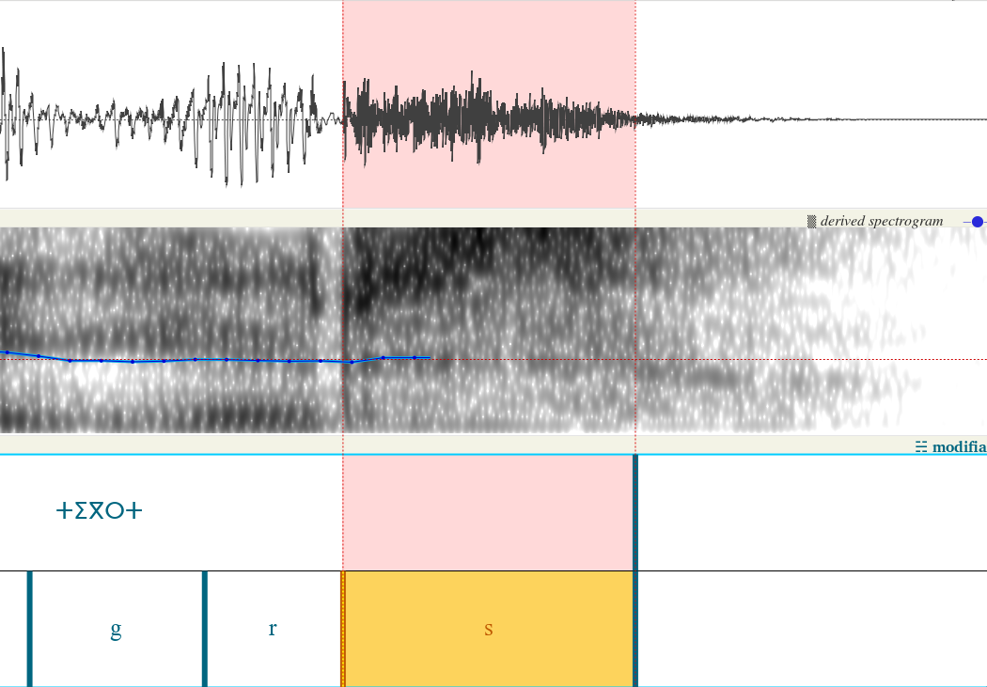
Manual analysis: Unaccounted assimilations
”t” is /s/ at pure ends.
Long ”a” may get /j/ inbetween (/aja/)
shi/Common_voice_22_0_9
shi/Common_voice_22_0_10

Slide 43
Manual analysis: TZM
Geminates are not particularly longer
Bad with /b/
More common plosives without prior pause
“n” commonly misslabeled
Noisier audios, very clear and slow pronunciation
Significantly longer /t/ and /s/, particularly at end-of-word

Slide 44
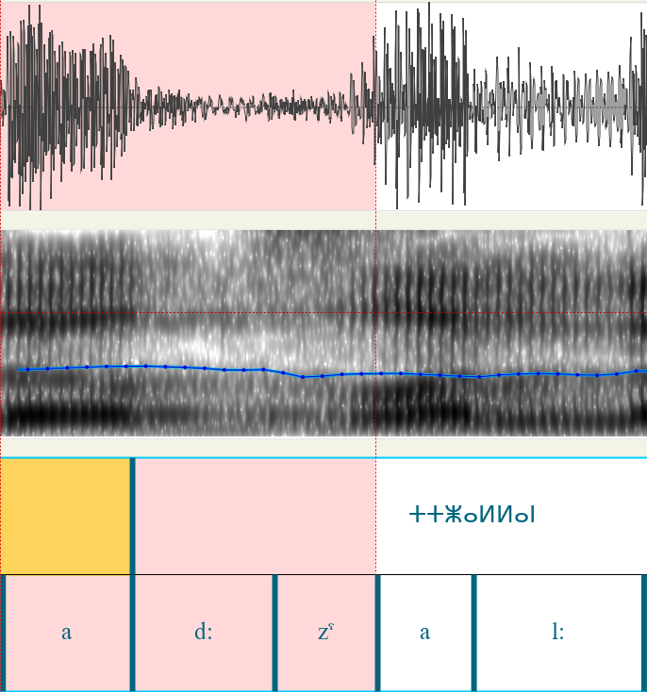
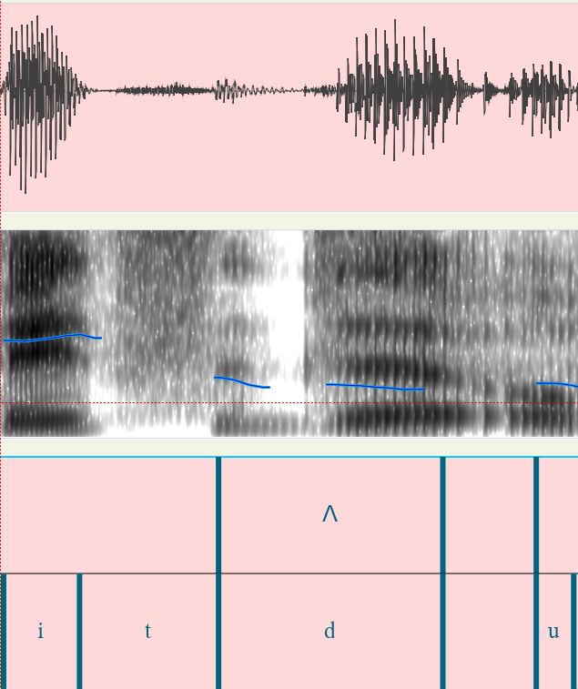
Manual analysis: Unaccounted assimilations
”t:” becomes voiced /d:/ when surrounded by voiced
”td” is /θd/ (may be speaker lisp)
tzm/Common_voice_22_0_7
tzm/Common_voice_22_0_4

Slide 45
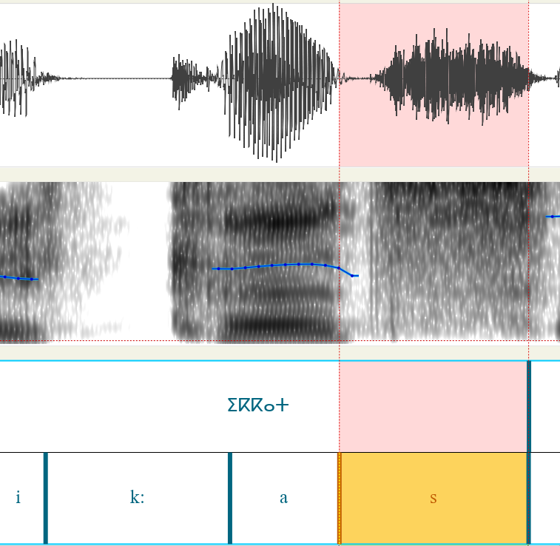
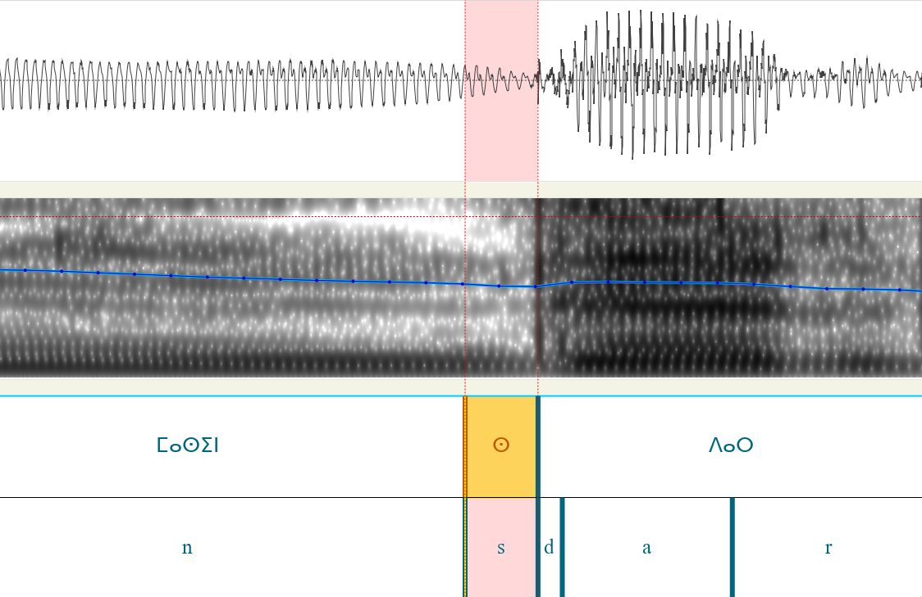
Manual analysis: Unaccounted assimilations
”t” is /ts/ before some pauses
Unpronounced /s/
tzm/Common_voice_22_0_12
shi/Common_voice_22_0_10

Slide 46
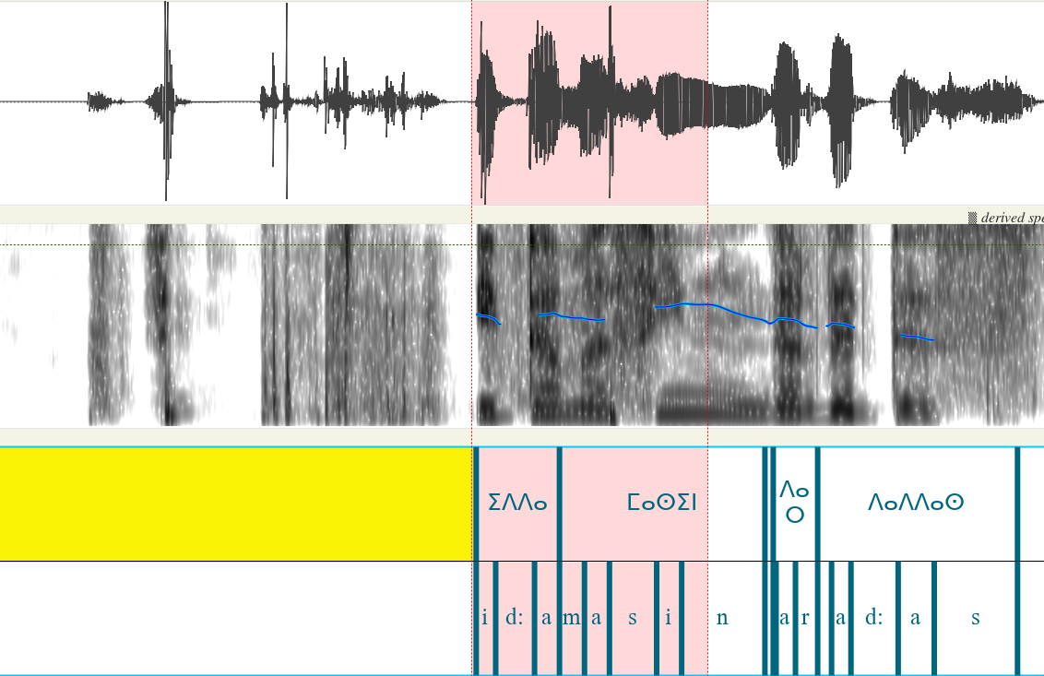
Manual analysis: MFA Impressively good at ignoring noise
Automatic annotation
Knocking noises
tzm/Common_voice_22_0_17

